Slide 1
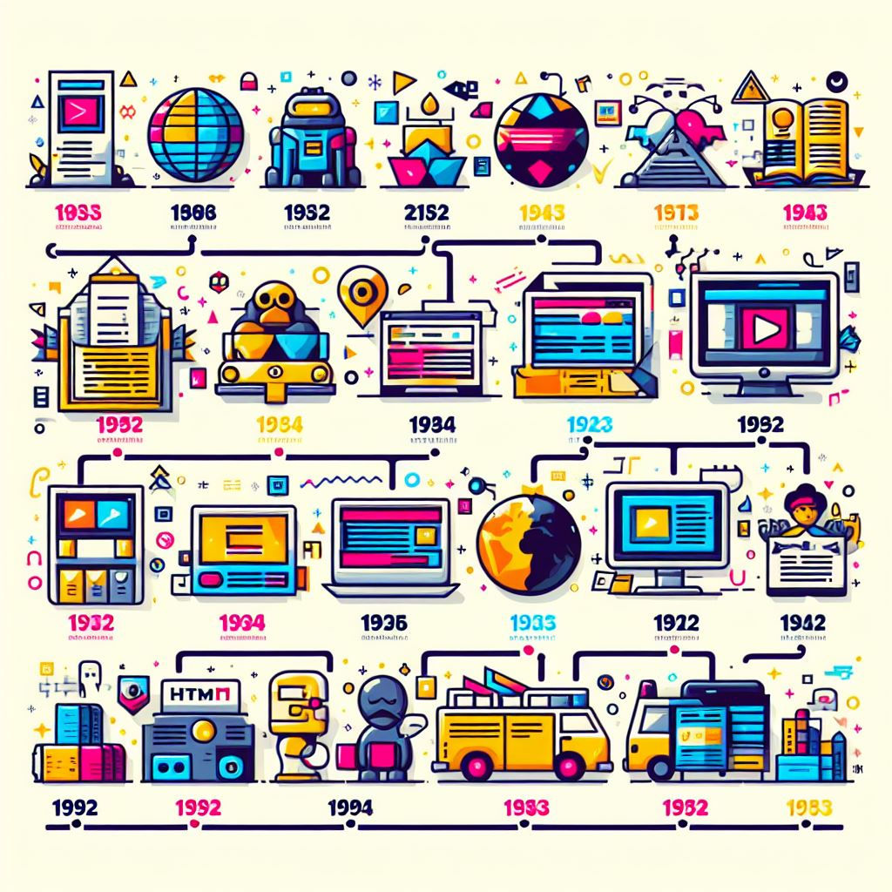
INTRODUCTION To Timeline Event using HTML and CSS
This project is a timeline representation webpage showcasing historical events between the years 1885 and 1905. The timeline is visually presented using a responsive design with an aesthetic combination of colours. Each event is encapsulated within a card, providing a structured and engaging way to explore the historical information. The timeline covers a period of great significance in Indian history, which saw the emergence of the Indian National Congress as a political force.

Slide 2
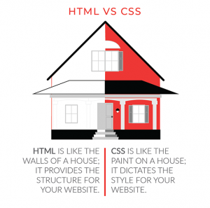
HTML and CSS: The Architects of Time
At the heart of this endeavour lie two faithful companions: HTML and CSS. Let’s introduce them:
HTML (Hypertext Markup Language):The backbone of web content . With its semantic tags, we structure our timeline—each event a carefully labelled node , each era a chapter waiting to be explored.
CSS (Cascading Style Sheets):The artist’s palette.CSS adds flair , colours , and layout magic . It transforms our raw data into an aesthetically pleasing journey . Fonts dance , colours harmonize , and animations breathe life into our historical canvas.

Slide 3
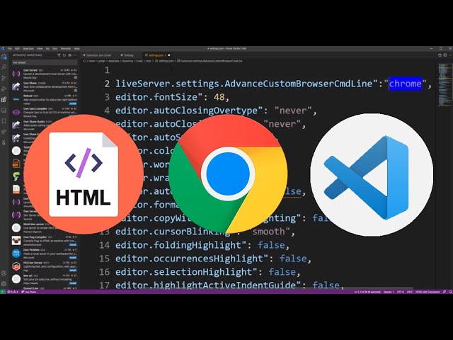
Software and Hardware Requirements
1-A text editor and IDE that supports HTML and CSS syntax: Visual Studio Code and MinGW-W64.
2-A web browser that can render HTML and CSS : Chrome and Internet Explorer.
3-A device that can run the text editor and the web browser : Laptop.
4-Internet Connection (for online image resources).

Slide 4
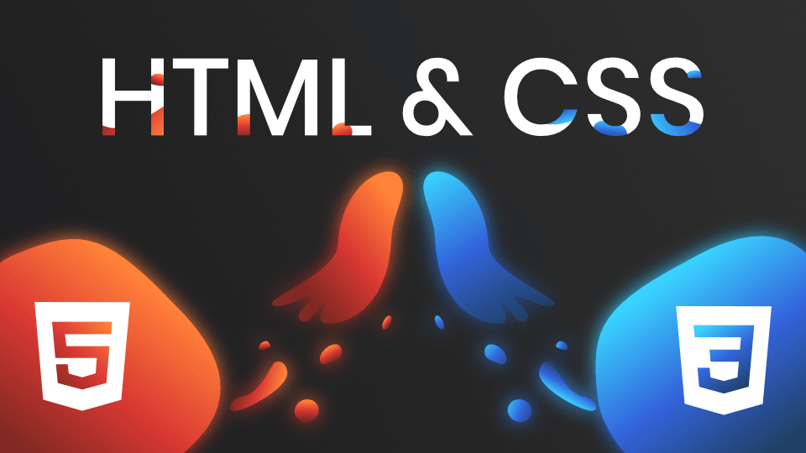
Technology Used
The project is implemented using HTML and CSS. The following technologies and techniques have been utilized:
1. HTML: Used for structuring the content of the webpage, including headings, paragraphs, lists, and images.
2. CSS: Applied for styling and layout. The styling includes background gradients, border styling, and responsive design for optimal viewing on various devices.
3. Responsive Design: The webpage is designed to be responsive, ensuring a seamless viewing experience on devices of different screen sizes.

Slide 5

Implementations
Timeline Structure:
•The timeline is structured using a series of cards, each representing a historical period.
•The timeline utilizes a unique visual style with borders and dots to enhance the overall presentation.
Image:
•An image is included at the top of the page to provide a visual context for the historical period covered.
Information Cards:
•Each event is encapsulated within a card that includes a title and a description.
Styling:
•The styling of the timeline is carefully crafted to provide an aesthetically pleasing and visually engaging experience.

Slide 6

OUTPUTS

Slide 7
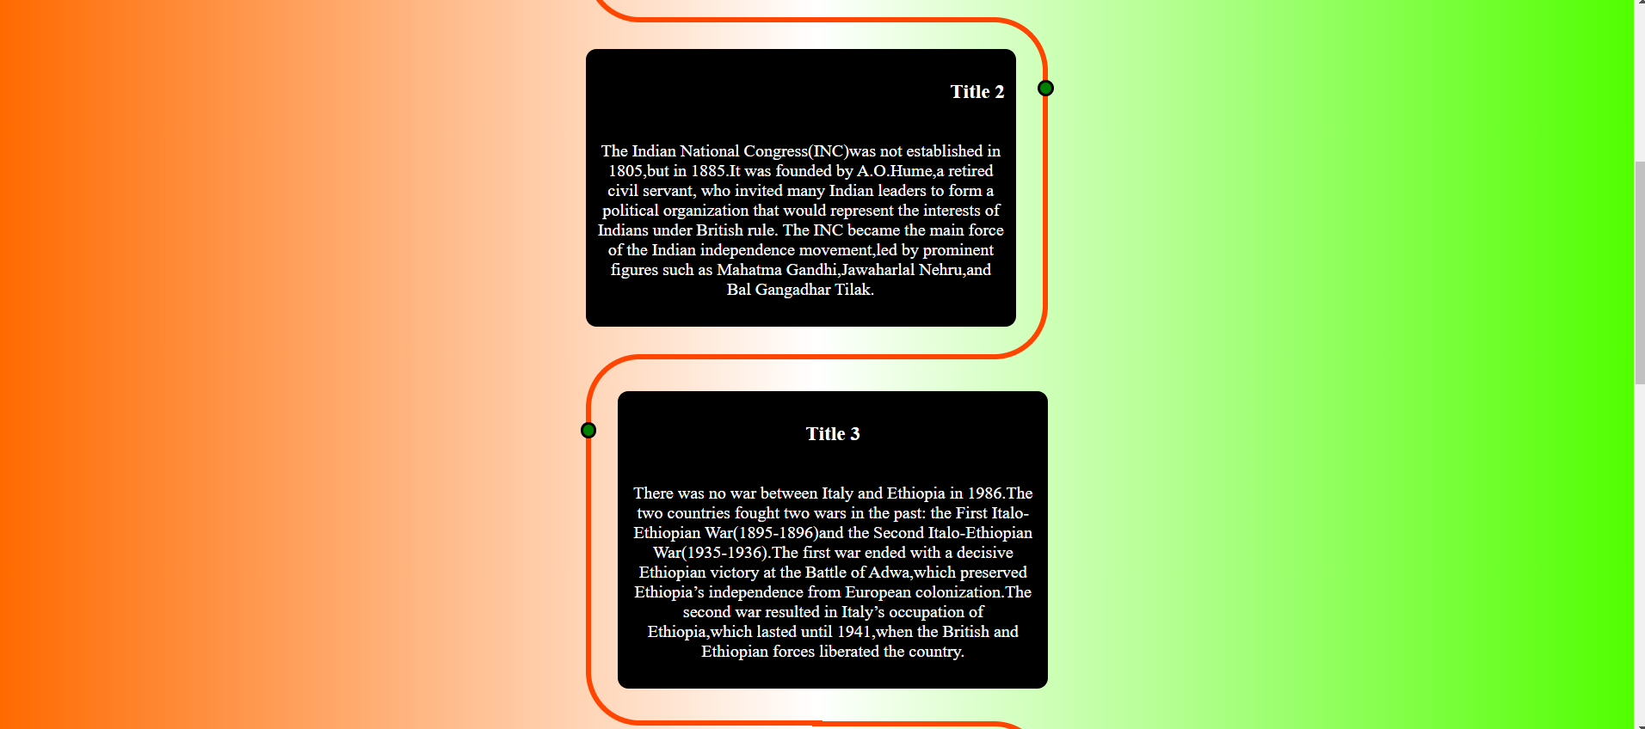

Slide 8
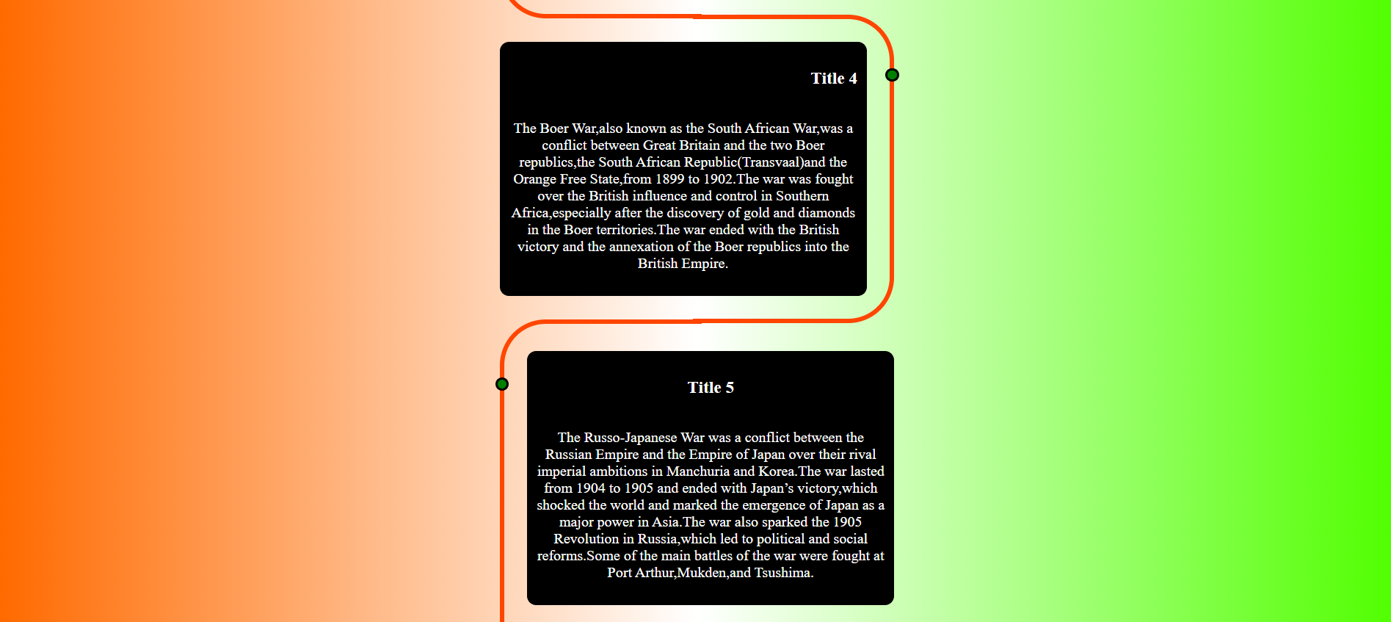

Slide 9
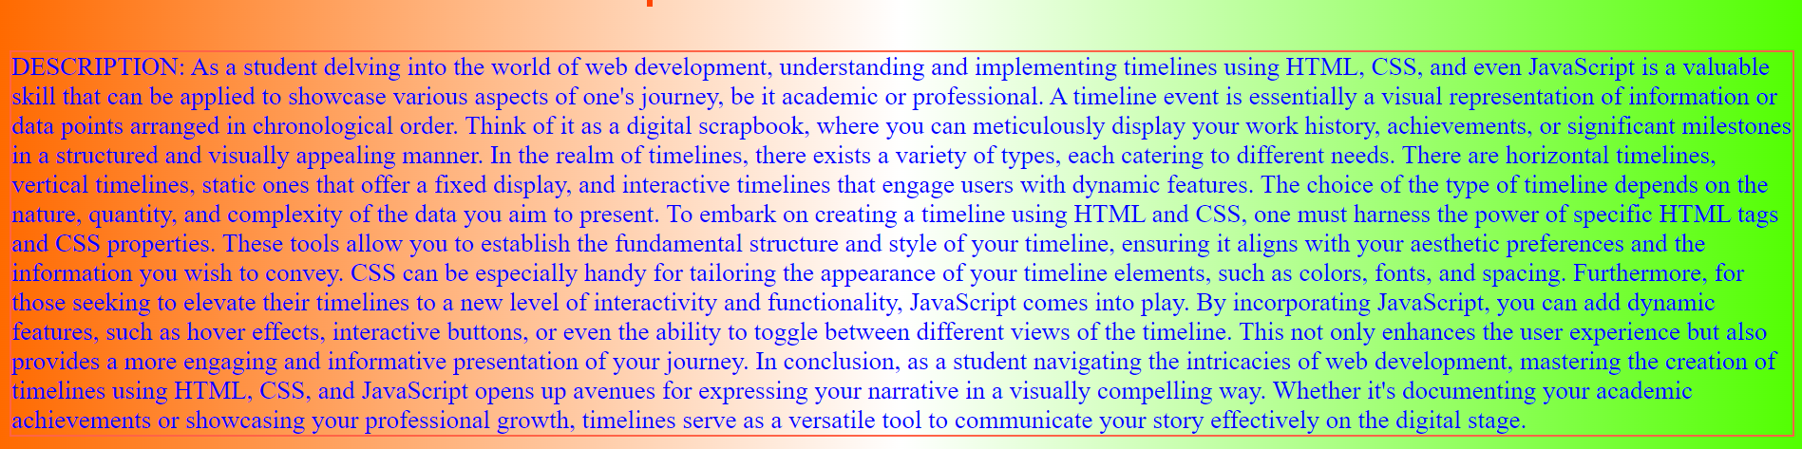

Slide 10
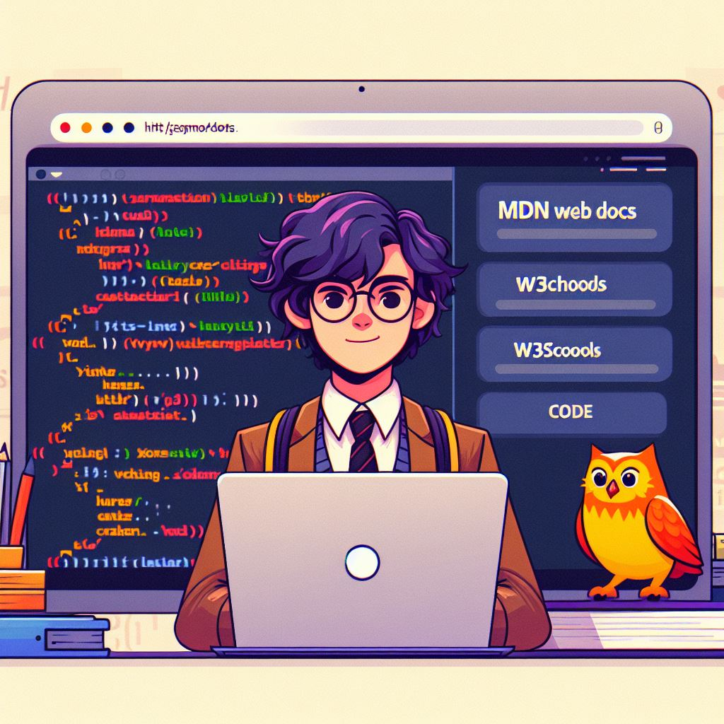
References
1. MDN Web Docs - HTML
2. MDN Web Docs - CSS
3. W3Schools - HTML Tutorial
4. W3Schools - CSS Tutorial
5. Code with Harry

Slide 11

Conclusion
This timeline project serves as an interactive and visually appealing way to explore historical events. The combination of HTML and CSS technologies allows for a straightforward and effective implementation, providing an informative and engaging user experience . The timeline elegantly arranges historical events in chronological order , allowing users to traverse centuries , decades, or even moments with ease . Each event becomes a stepping stone , connecting past , present, and future.HTML and CSS collaborate harmoniously to breathe life into the timeline . The judicious use of fonts , colours , and layout ensures a visually appealing canvas . Users are drawn in by the aesthetics , ready to explore further . Clickable markers or scrollable sections transform static information into an interactive experience . Users can immerse themselves in specific eras , clicking on events to reveal details , images , or related content . The timeline adapts gracefully to various devices—whether viewed on a desktop monitor , tablet , or smartphone . Consistency across platforms ensures accessibility for all curious minds . Beyond aesthetics , the timeline serves as an educational resource. Students , history enthusiasts , and curious souls can learn about pivotal moments , cultural shifts , and human achievements . It’s a virtual time-travel capsule . Each event snippet—crafted with HTML—holds a story . Whether it’s the signing of a treaty , a scientific breakthrough , or a revolution , the concise descriptions transport users to that moment in history . Cascading Style Sheets(CSS) add flair . Borders , shadows , and animations subtly enhance the user experience . A well-designed timeline isn’t just informative , it’s delightful . Semantic HTML tags ensure screen readers interpret the content accurately . Alt text for images and proper structuring make the timeline inclusive for all users . As events unfold, the timeline can evolve. Collaborate with historians, educators, or fellow enthusiasts to refine and expand . Continuous improvement keeps the narrative fresh . Your HTML and CSS-powered timeline isn’t just a project; it’s an inspiration . Others may embark on their own historical journeys , field by your creativity and dedication . In the vast expanse of time, your timeline stands as a beacon—a digital monument to human progress , resilience , and curiosity.

Slide 12

About Us
We are a dynamic team of budding technologists from Thakur College of Science and Commerce. Our passion for innovation and collaboration drives us to create meaningful projects. Here’s a glimpse into our journey:
1-Vishal Tiwari
Major: FY BSc IT/B
Enthusiastic coder and problem solver
Loves exploring the intersection of technology and creativity
2-Siddhi Parab
Major: FY BSc IT/B
Detail-oriented designer with an eye for aesthetics
Believes in the power of user-friendly interfaces
3-Aryan Bhandari
Major: FY BSc IT/B
Aspiring front-end developer
Passionate about crafting seamless web experiences
Acknowledgments
We extend our heartfelt gratitude to our respected teacher, Miss Rimsy Dua, for guiding us through this project. Her expertise and encouragement have been invaluable.

